Slide 1
PROBLEM STATEMENT
Introduction to GenAI and Simple LLM Inference on CPU and finetuning of LLM Model to create a Custom Chatbot

Slide 2
Unique Idea Brief (Solution) :
Start by introducing the concept of GenAl (General Artificial Intelligence) and its significance.
Highlight the problem GenAl aims to solve—bridging the gap between human intelligence and machine capabilities.
Emphasize the uniqueness of your approach in using LLMs (Large Language Models) for chatbot development.

Slide 3
Features Offered:
Enumerate the key features of your proposed chatbot
• Natural language understanding
• Context-aware responses
• Scalability
• Customizability
• Integration with existing systems

Slide 4
Process Flow:
Illustrate the step-by-step process of how the chatbot
interacts with users:
User input
Preprocessing
LLM inference
Response generation
Feedback loop

Slide 5
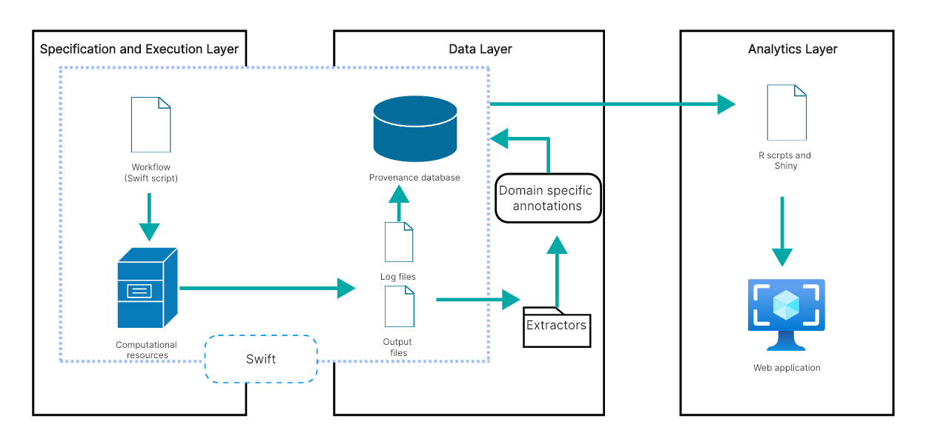
Architecture Diagram:

Slide 6
Technologies Used:
Python (for coding)
Streamlit (for user interface)
Hugging Face Transformers (for LLMs)

Slide 7
Team Members and Contributions:
Sole Contributor: Maniteja Gaddam
Contributions:
Model Fine-Tuning: Trained and fine-tuned the LLM (Large Language Model) for chatbot functionality.
User Interface Design: Created an intuitive and user- friendly interface using Streamlit.
System Integration: Seamlessly integrated various components. ensuring smooth communication between user input preprocessing. and model inference.
Deployment and Testing: Deployed the chatbot system and rigorously tested its performance.

Slide 8
Conclusion:
In this presentation, we have explored the foundational aspects of Generative AI (GenAI) and its application through Large Language Models (LLMs)
Introduction to Generative AI and LLMs
Simple LLM Inference on CPU
Fine-tuning LLMs for Custom Applications
Building a Custom Chatbot

